Slide 1


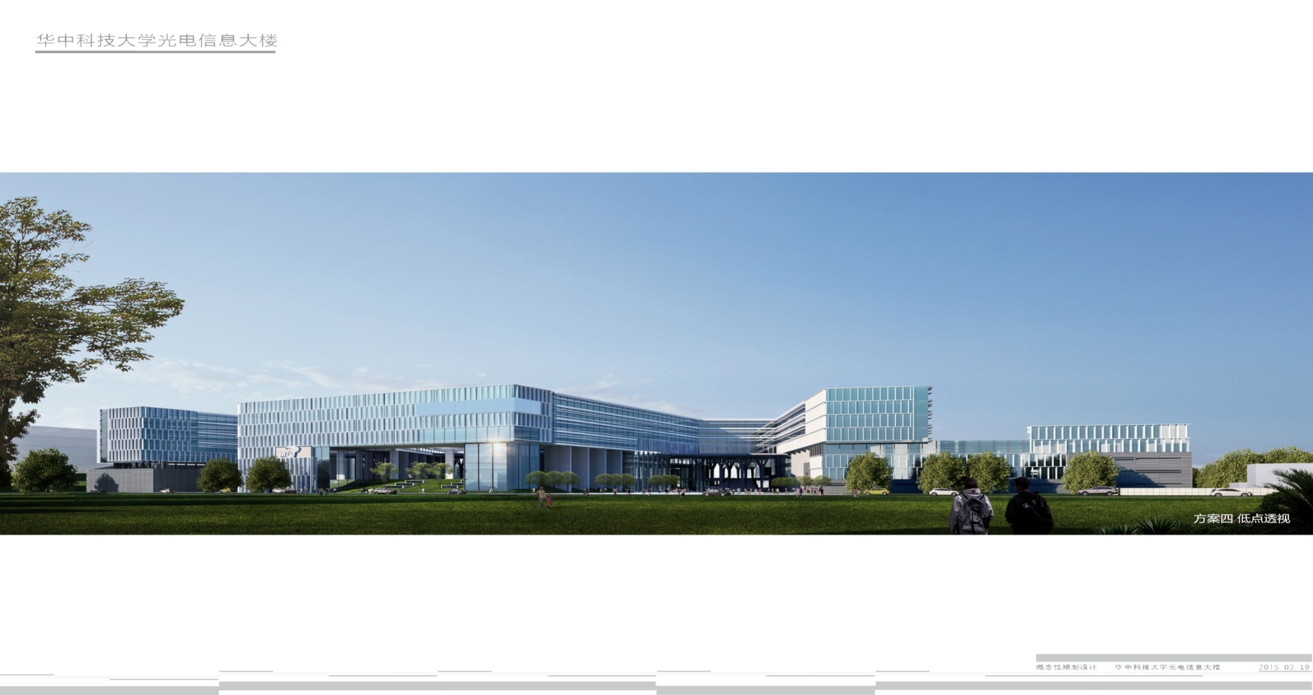
Weekly Report
Speaker :Ying Jie

Slide 2

Content
1. Basic Knowledge Learnig & Works
· Survey
2. Paper Reading
· Overview: Camera Lidar Fusion
· Zoom to Learn, Learn to Zoom
· Differentiable Event Stream Simulator for Non-Rigid 3D Tracking
3. Plan For Next Week
· Finish most parts for my survey
· Paper Reading & rethink for ideas

Slide 3
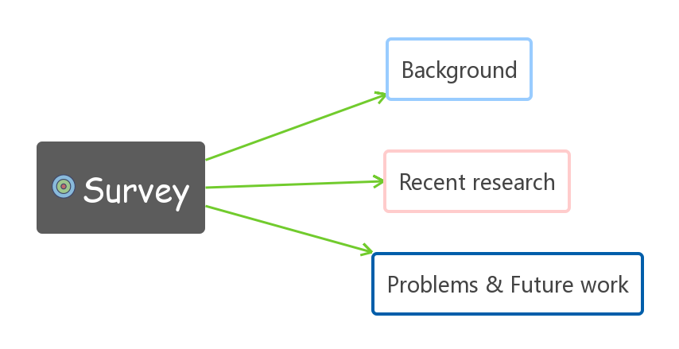
Some ideas for my survey & research paper

Slide 4
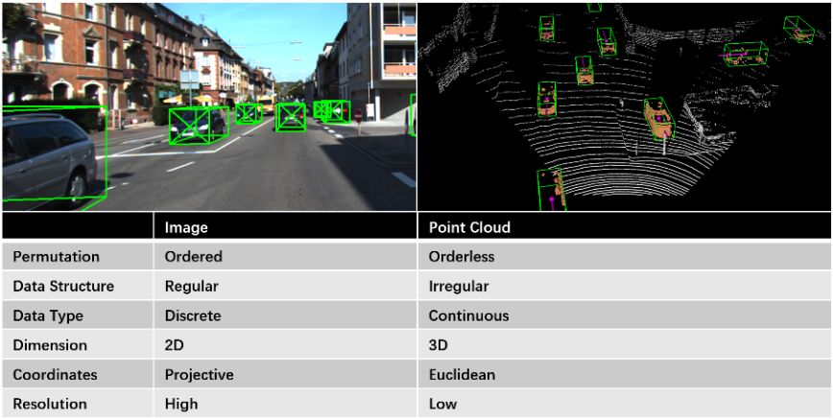
Overview: Camera Lidar Fusion
Monocular visual perception system achieves satisfactory performance at its low cost, but it cannot provide reliable 3D geometric information.
The huge difference in image and point cloud processing algorithms, in the left figure compared the characteristics of the point cloud and image.

Slide 5
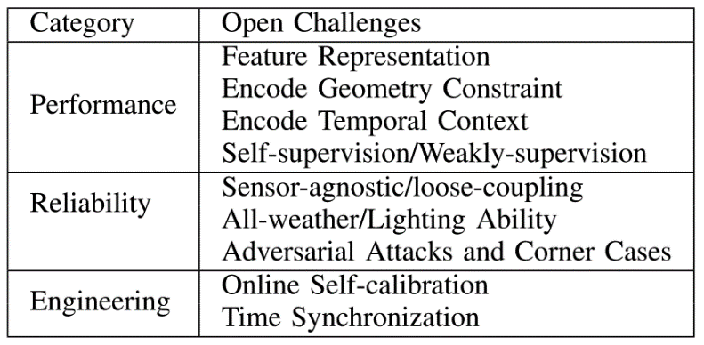
Trends, challenges and future research directions

Slide 6
Performence Problem——Solution
1) Feature representation of fused data
· Additional depth information channels on RGB images
·Additional RGB channels on the point cloud image
·Transform image and point cloud features into other data representations
2) Add geometric constraints
3) Add a time context
4) Deep learning network structure design
5) No supervision or weak supervision

Slide 7
Reliability Problem——Solution
1) Sensor independent fusion framework
2) All-weather/light working ability
3) Combat aggression and extreme cases

Slide 8
Open research questions relating to engineering
1) Online self-calibration of sensor
2) Sensor time synchronization
3) Deep completion

Slide 9
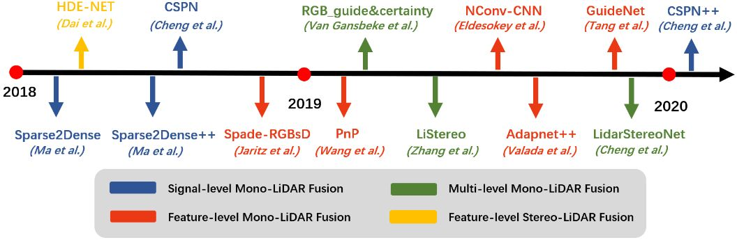
Deep completion Timemap

Slide 10
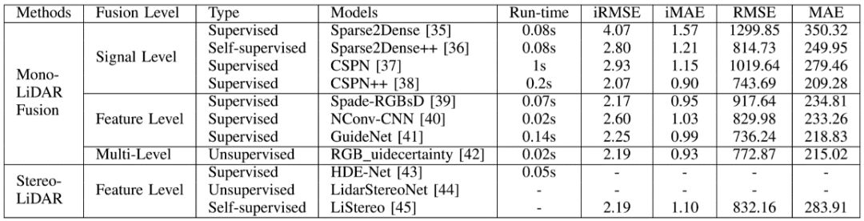
Open research questions relating to engineering

Slide 11
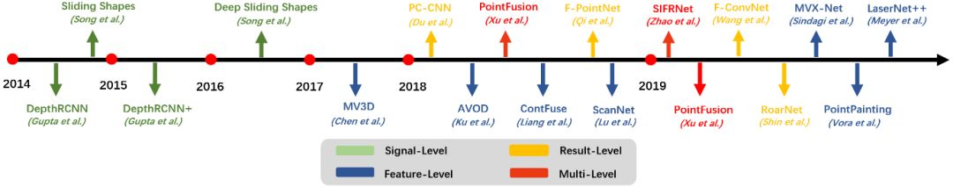
3D object recognition Timemap

Slide 12
Open research questions relating to engineering
A. Multi-stage model based on 2D Proposal
B. Multi-stage model based on 3D Proposal
C. Single-stage model

Slide 13
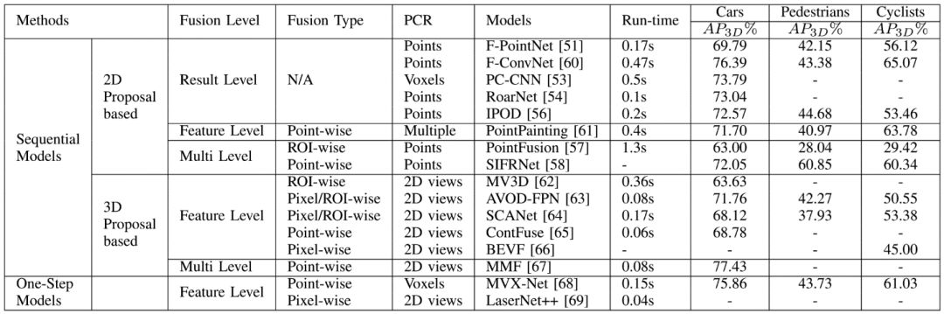
A whole table to illustrate models

